Slide 1
Cards and Actions using Outlook Actionable Messages
Card design & MessageCard Playground

Slide 2

Card design & MessageCard Playground
Design guidelines
Text formatting
Card fields
Section fields
Actions
Inputs

Slide 3

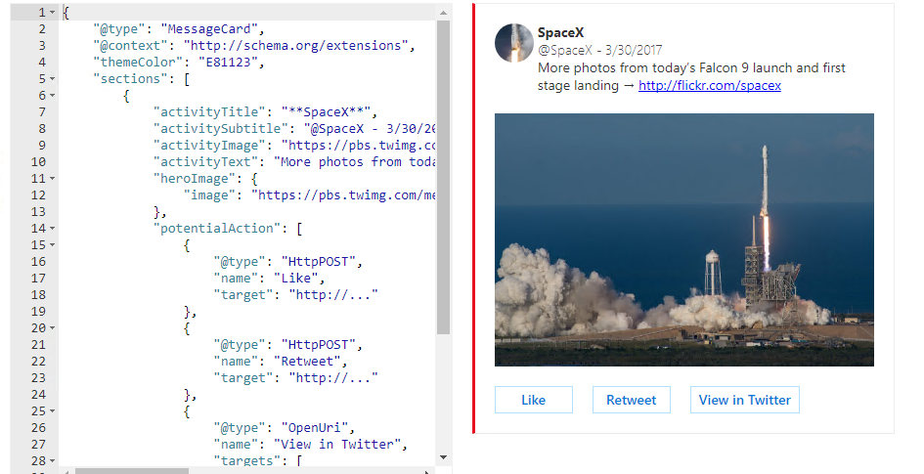
MessageCard Playground
https://messagecardplayground.azurewebsites.net
Notes:
Use the MessageCard Playground to view samples and design your own cards

Slide 4
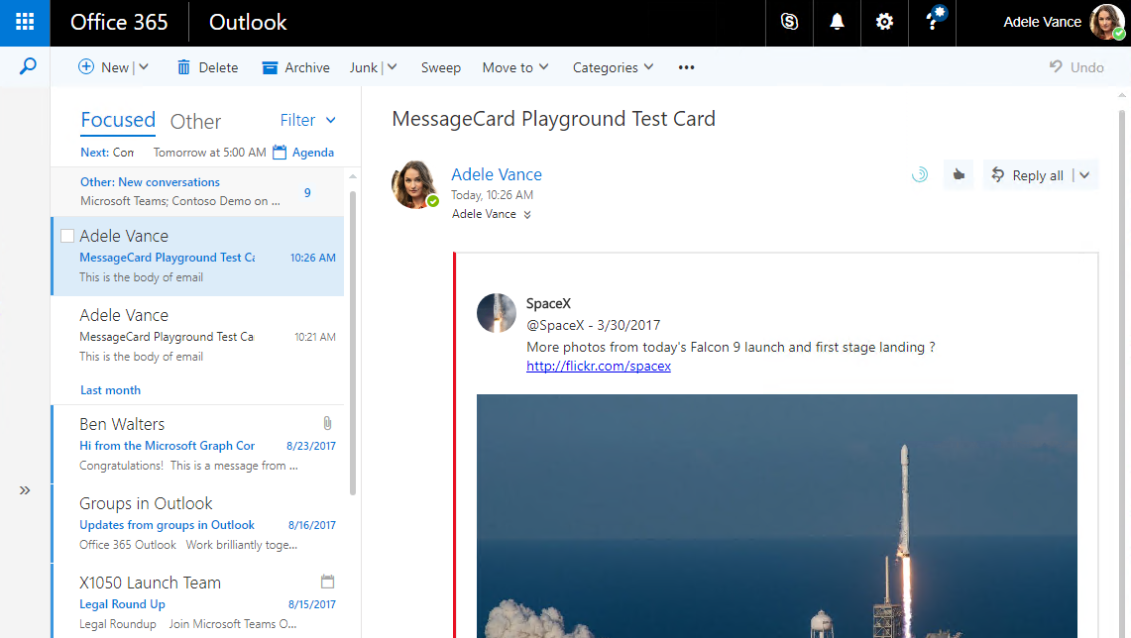
MessageCards in Outlook
Notes:
Send the card to your inbox to view and test your card.
Note that httpPOST URLs to process actions won’t work yet until we register with the developer dashboard, this is covered in the next section of the module.

Slide 5
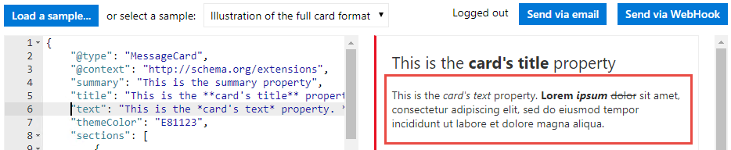
Text formatting with basic markdown
Effect | Markdown
Italics | *Italic*
Bold | **Bold**
Bold italics | ***Bold italics***
Strikethrough | ~~Strikethrough~~
Links | [Microsoft](https://www.Microsoft.com)
Headings | # Heading through ###### Heading
Bulleted lists | * List item or - List item
Notes:
All text fields in the card support markdown.

Slide 6
Card fields
Field | Type | Description
@type | String | Required, must be “MessageCard”
@context | String | Required, must be “http://schema.org/extensions”
summary | String | Displayed in the list view in Outlook to quickly identify what the card does
themeColor | String | Custom brand color for the card
hideOriginalBody | Boolean | Only applies to cards in email messages, causes the HTML body to be hidden
title | String | Rendered prominently at the top of the card
text | String | Rendered normally below the title
Notes:
hideOriginalBody is useful if the card itself contains all the information a user would need or if the content of the card is redundant with the content of the body. Always include an HTML body as that is rendered for clients that do not support cards.
Don’t use hyperlinks or markdown in the title.
Can use hyperlinks or markdown in the text.

Slide 7
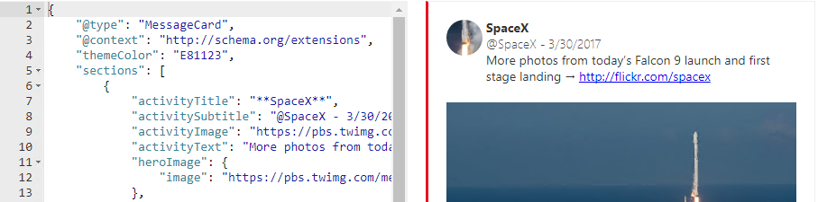
Section fields
Field | Type | Description
title | String | Rendered prominently as the title of the section, not as prominent as the card’s title
startGroup | Boolean | Marks the start of a logical group of information, will be visually separated from previous card elements
activityImage activityTitle activitySubtitle activityText | String | Forms a logical group of information displayed using a device-appropriate layout
heroImage | Image | Makes an image the centerpiece of the card section
text | String | Rendered normally below the section title
facts | Array | Name value pairs
images | Array | Image objects
potentialAction | Array | Actions that can be invoked on this section
Notes:
Don’t use hyperlinks in the title
Example of a news article abstract:
Use activityImage to display the picture associated with the article
Use activitySubtitle to display the date and time the article was originally posted
Use activityText to display the actual abstract
Use facts to present metadata such as publish date, image credits, and other citation data

Slide 8
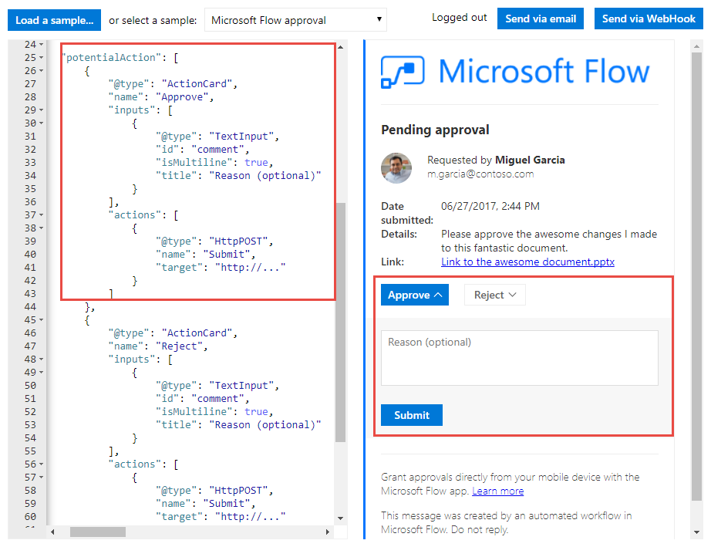
Actions
OpenUri
Opens a URI in a separate browser or app
HttpPost
Makes a call to an external web service
ActionCard
Presents additional UI that contains one or more inputs (text, date, or multichoice) and action (OpenUri or HttpPost)

Slide 9
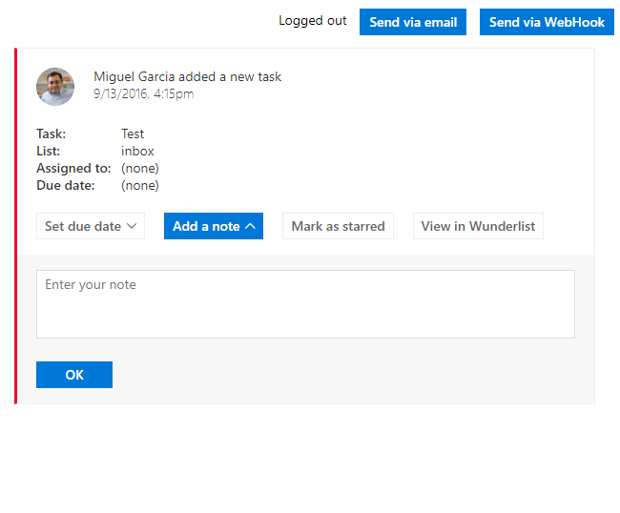
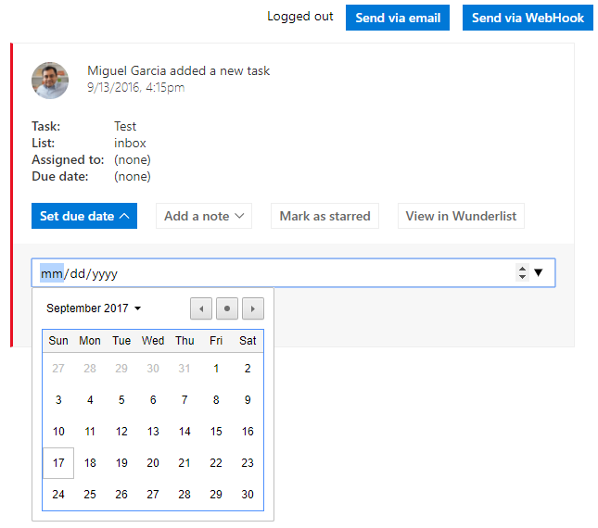
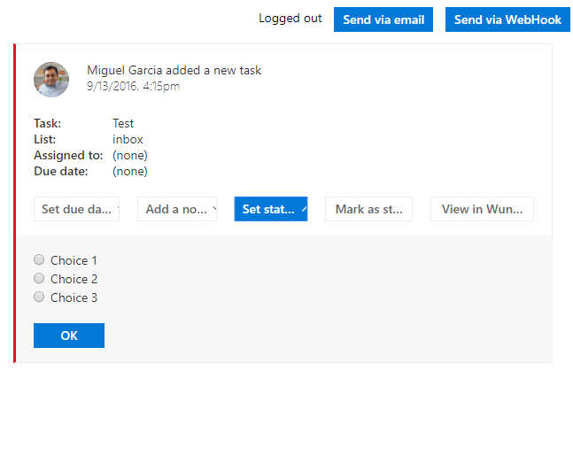
Inputs
TextInput
Use when you need users to provide text.
DateInput
Use when you need users to provide a date and/or a time.
MultichoiceInput
Use when you need users to select from a list of pre-defined choices.

Slide 10
Reporting success or failure
CARD-ACTION-STATUS
HTTP header indicating success or failure to the user
public async Task <HttpResponseMessage> Post([FromBody]string value)
{
if (ExpenseModel.IsApproved(value))
{
var response = Request.CreateResponse(HttpStatusCode.OK);
response.Headers.Add("CARD-ACTION-STATUS", "The expense was approved.");
return response;
}
else
{
var failResponse = Request.CreateResponse(HttpStatusCode.BadRequest);
failResponse.Headers.Add("CARD-ACTION-STATUS", "Failed to approve expense report.");
return failResponse;
}
}
Notes:
Use the CARD-ACTION-STATUS header to provide descriptive text if the operation succeeds or fails.
Do not include user information in the status.

Slide 11
Refresh cards
Allows an HttpPOST action to fully update the card as the action successfully completes
Include the JSON payload of the new card in the body of the response
Add the CARD-UPDATE-IN-BODY: true header to the response
bool approved = ExpenseModel.IsApproved(value);
if (approved)
{
var response = Request.CreateResponse(HttpStatusCode.OK);
response.Headers.Add("CARD-ACTION-STATUS", "The expense was approved.");
//Refresh card
response.Headers.Add("CARD-UPDATE-IN-BODY", "true");
response.Content = new StringContent(ExpenseModel.GetCardBody(value));
return response;
}

Slide 12
Demo

Slide 13

Summary
MessageCard Playground app has useful samples to draw from
Customize samples or load your own samples to visualize
Send emails to yourself to test in mail clients

Slide 14
Thank you

